Slide 1


Epi-Info Essentials: Simple, Powerful Tool for Smarter Data Work
Felix Emeka Anyiam,
MPH (EUCLID, CAR), MSC.PH (UNIPORT), Data Science (Trieste, Italy), Ph.D. (DUT, SA)
 +234.806.499.5462
 felix.emeka.anyiam@gmail.com ✓ http://orcid.org/0000-0003-2774-7406

Slide 3
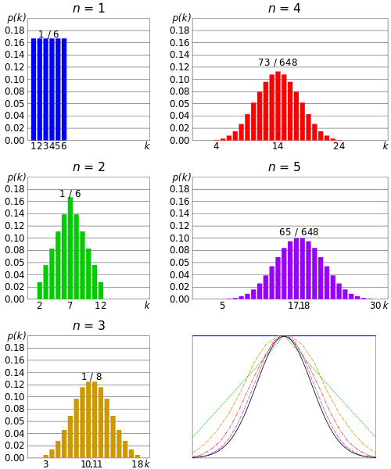
Normally Distributed Data
Image source: https://en.wikipedia.org/wiki/File:Dice_sum_central_limit_theorem.svg

Slide 4
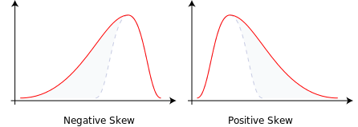
General Measures of Skewness
1. A skew (> +1) = high degree of positive skew
2. A skew (< -1) = high degree of negative skew
3. A skew (between -1 and +1, near to zero) = symmetric data set
Kurtosis: (-2 and + 2)
Image source: https://en.wikipedia.org/wiki/File:Negative_and_positive_skew_diagrams_(English).svg

Slide 5
Normality using Shapiro-Wilk Normality test using SPSS
SPSS will give you 2 forms: (a) The kolmogorov-Smirnov Test and (b) Shapiro-Wilk Test.
Shapiro-Wilk Test is more appropriate as it can handle sizes from 50-2000.
INTERPRETATION
P-value >0.05, the data is Normal
P-value ≤ 0.05, the data significantly deviates from a normal distribution
Methods:
1. Numerical
2. Graphical
Analyze > Descriptive Statistics > Explore > Add your dependent variables (continuous) > Set the Confidence Interval (CI) @ 95% > Select the ‘normality plots with tests’.

Slide 6
Statistical Test
(Test of Association)
Differences in Means
[Parametric]
Differences in Medians
[Non Parametric]
Differences in Proportions
[Both]
Two Means
3 or more Means
Two Medians
3 or more Medians
Large Sample
(≥5)
Small Sample
(<5)
Independent
Analysis of Variance (ANOVA)
Mann-Whitney
Kruskal-Wallis
Chi-Square (X2)
Fisher’s Exact
Student T-test
One Way
Two Way
Comparing two Continuous variables
Dependent (Paired)
Post-Hoc analysis
Tukey-Kramer HSD
Paired Student T-test
Spearman's rho Coefficient (ORDINAL)
Pearson’s Correlational Coefficient (r)

Slide 7


